Slide 1
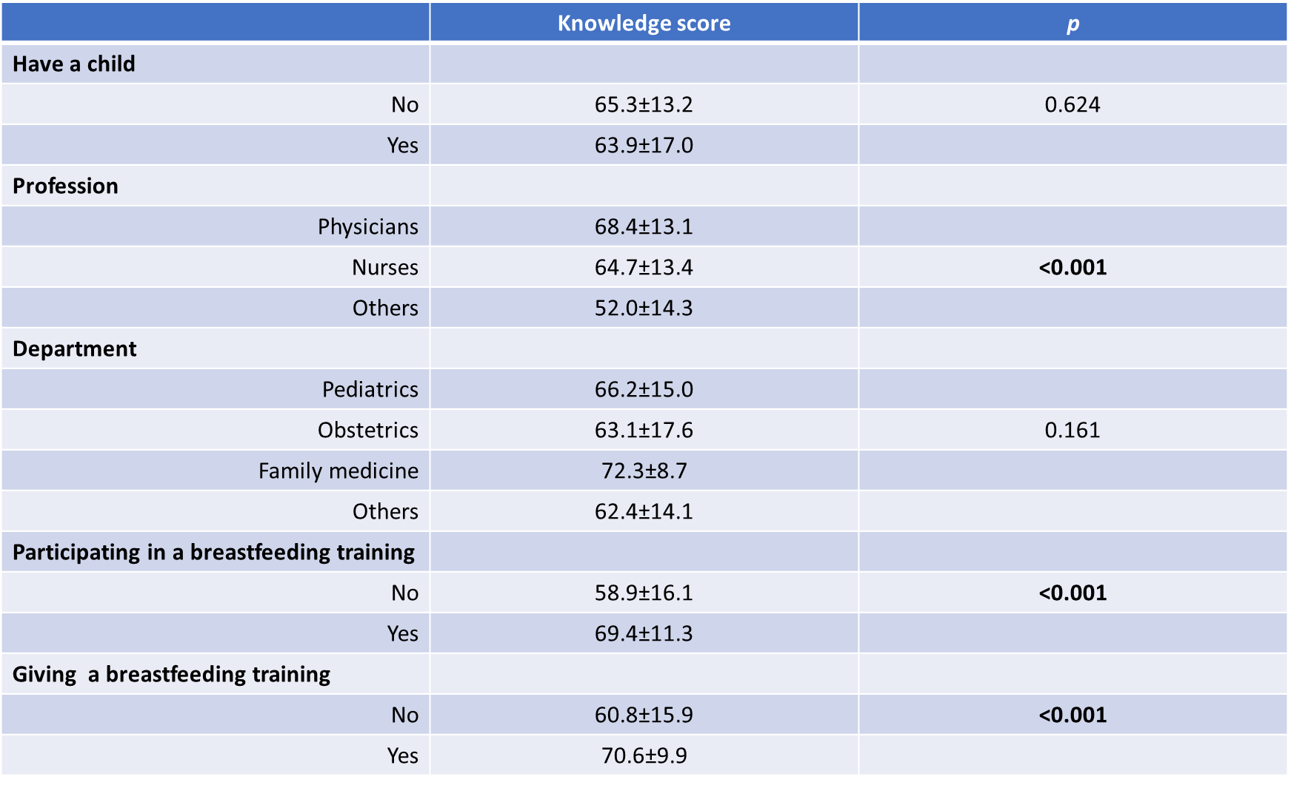
Awareness of Breast Milk and Breastfeeding Practices Among
Female Healthcare Workers in Bezmialem Vakıf University
Suheda Erdem Ozdemir¹, Aysegul Dogan Demir²
¹Bezmialem Vakif University, Faculty of Medicine, Istanbul, Turkey
²Bezmialem Vakif University, Faculty of Medicine, Departmet of Pediatrics, Istanbul, Turkey
Introduction: Although breast milk is really important for the health of babies and mothers, there are still problems in starting and continuing breastfeeding. It’s known that there are lots of factors effecting breastfeeding practices but there’s no doubt that knowledge and attitude of healthcare professionals have a major role about this. For healthy generations, All healthcare professionals -especially female ones- should convey their knowledge and experience to mothers about this issue.
Method: In this study we aim to evaluate the awareness about the importance of breast milk among female healthcare workers and learn about their own breastfeeding practices with a 40-question survey. 117 female healthcare workers participated in our study, with or without children who works currently in Bezmialem Vakif University Hospital. The data obtained were evaluated with the SPSS analysis method.
Results: 68 (59%) physicians, 29 (25%) nurses and 19 (16%) healthcare workers from other professions participated in our study. The average age is 30 and 34% of them stated that they have children. Those who gave only breast milk to their first born baby for the first 6 months constitute 50% of those who have children. And those who continued breastfeeding for at least 2 years are only 24% of the mothers. 10% of them stated that their babies did not receive breast milk at all. The average knowledge level point is 65%. We found out that knowledge levels are correlated with age (p=0,015) and profession (p=0,007). Also those who educates mothers in their professional life (p=0,0001) and who attended an education programme (p=0,0001) have a higher level of knowledge.
Conclusion: As a ‘baby friendly’ foundation and a faculty university we must handle this issue more carefully in the faculty education for students and in the service training for professionals.
Keywords: Breastfeeding, Healthcare Workers, Breast Milk, Knowledge Level

